Slide 1
FRAMING
The data link layer needs to pack bits into frames.
Framing in the data link layer separates a message from one source to a destination, or from other messages to other destinations, by adding a sender address and a destination address.
Fixed-Size Framing: There is no need for defining the boundaries of the frames.
Variable-Size Framing : We need to define the end of the frame and the beginning of the next.

Slide 2
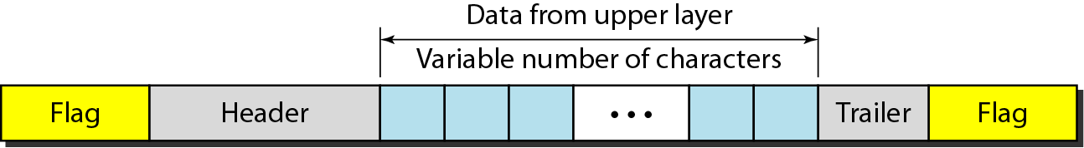
A frame in a character-oriented protocol

Slide 3
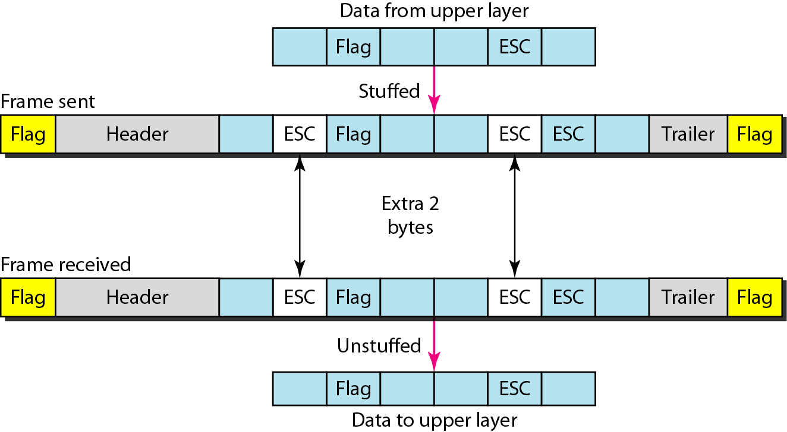
Byte stuffing and unstuffing
Byte stuffing is the process of adding 1 extra byte whenever there is a flag or escape character in the text.

Slide 4
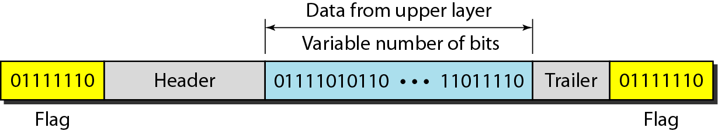
A frame in a bit-oriented protocol
Bit stuffing is the process of adding one extra 0 whenever five consecutive 1s follow a 0 in the data, so that the receiver does not mistake
the pattern 0111110 for a flag.

Slide 5
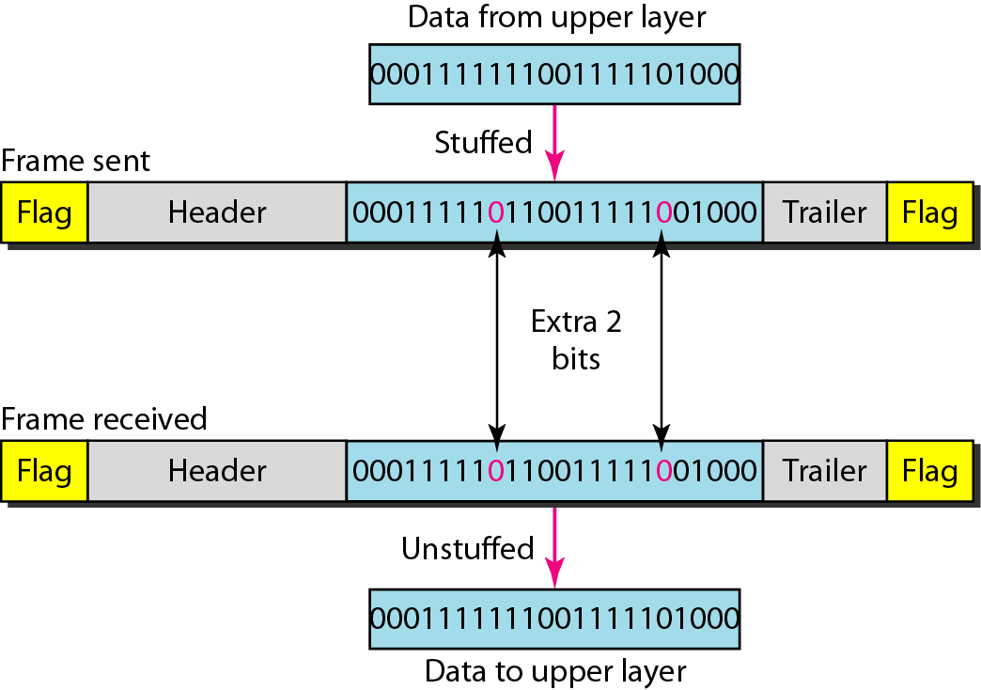
Bit stuffing and unstuffing

Slide 6
FLOW AND ERROR CONTROL
The most important responsibilities of the data link layer are flow control and error control..
Flow control refers to a set of procedures used to restrict the amount of data that the sender can send before waiting for acknowledgment.
Error control in the data link layer is based on automatic repeat request(ARQ), which is the retransmission of data.

Slide 7
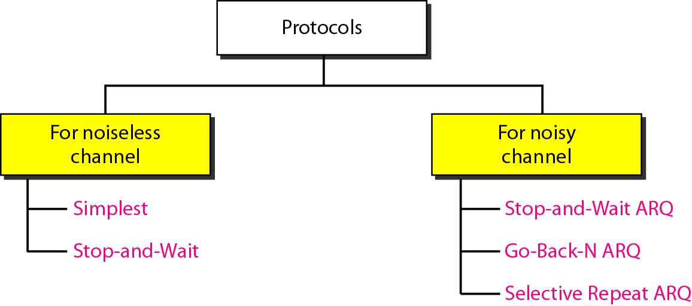
PROTOCOLS
Now let us see how the data link layer can combine framing, flow control, and error control to achieve the delivery of data from one node to another.

Slide 8
NOISELESS CHANNELS
Let us first assume we have an ideal channel in which no frames are lost, duplicated, or corrupted. We introduce two protocols for this type of channel.
Simplest Protocol Stop-and-Wait Protocol

Slide 9
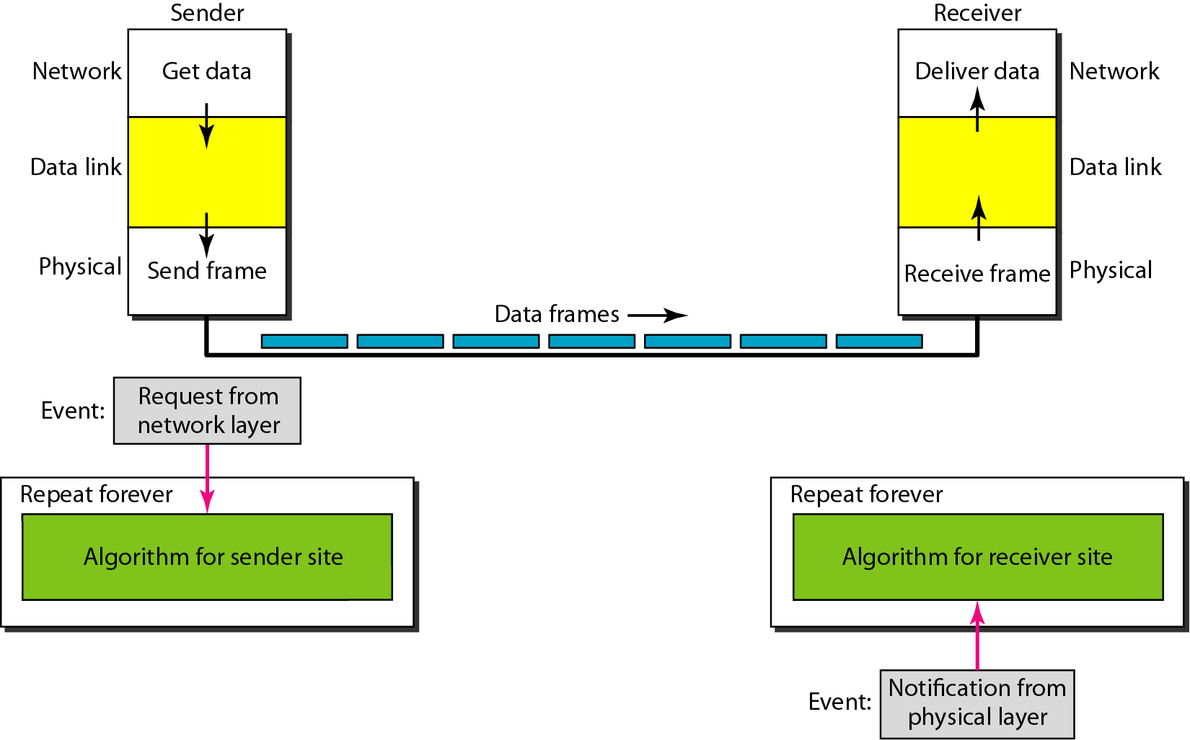
The design of the simplest protocol with no flow or error control

Slide 10
Algorithm Sender-site algorithm for the simplest protocol

Slide 11
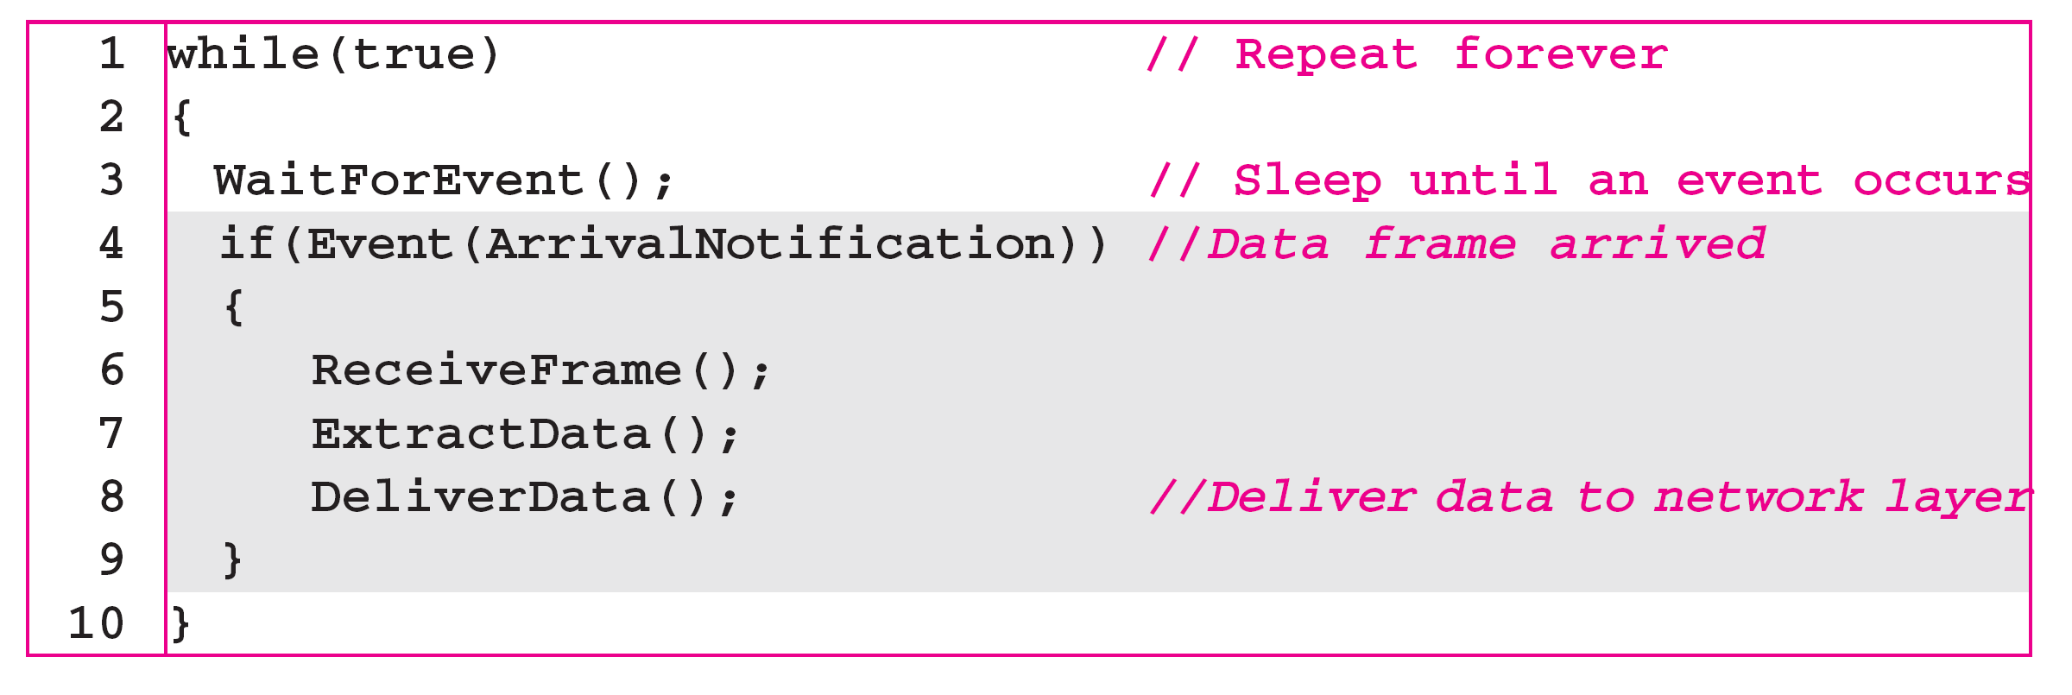
Algorithm Receiver-site algorithm for the simplest protocol

Slide 12
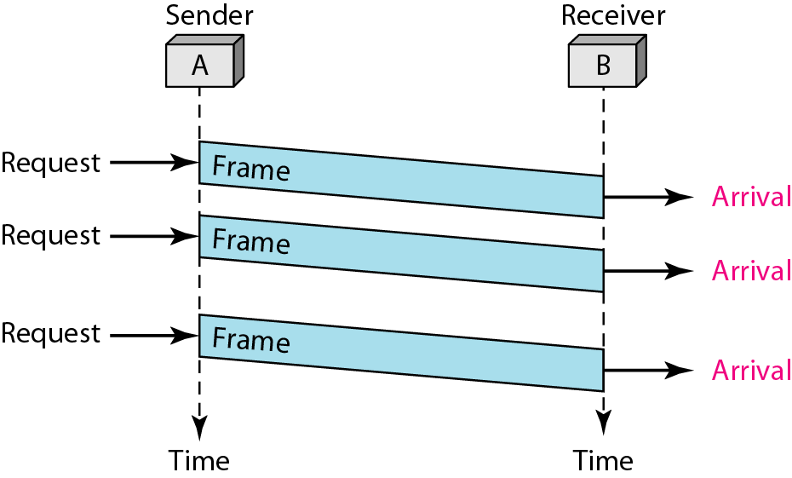
Example
Figure shows an example of communication using this protocol. It is very simple. The sender sends a sequence of frames without even thinking about the receiver. To send three frames, three events occur at the sender site and three events at the receiver site. Note that the data frames are shown by tilted boxes; the height of the box defines the transmission time difference between the first bit and the last bit in the frame.

Slide 13
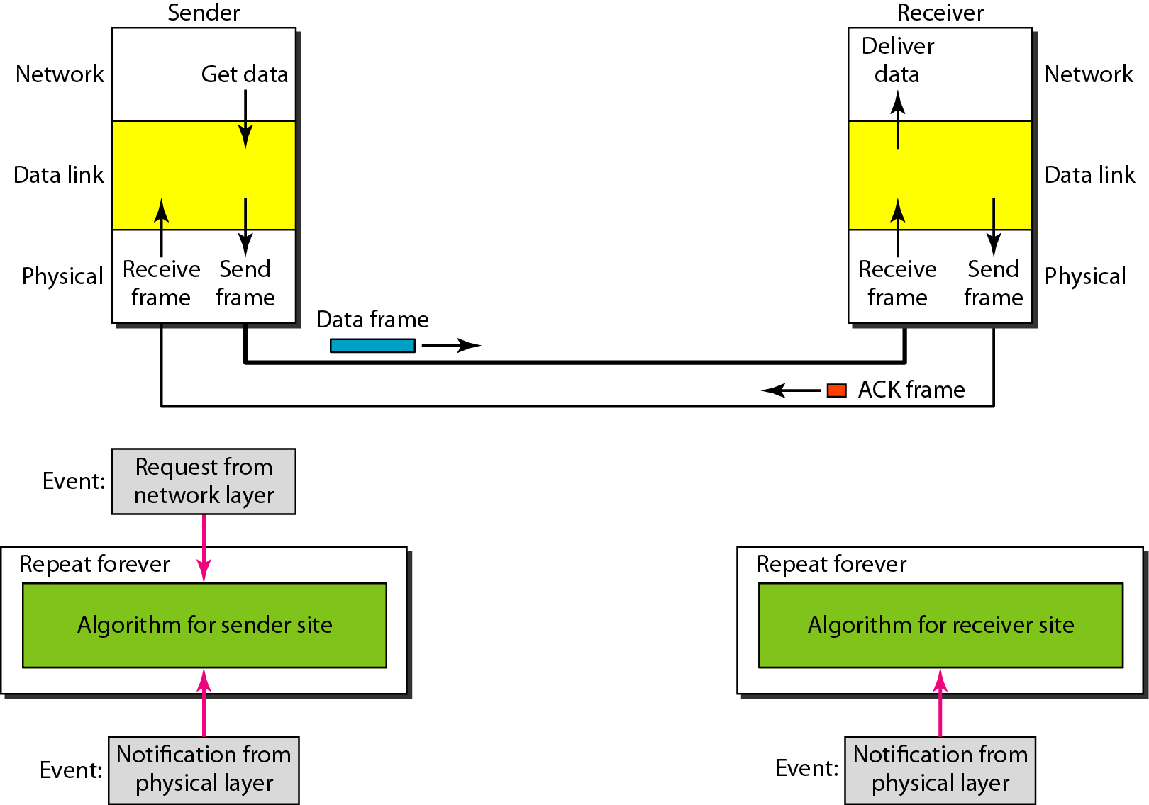
Design of Stop-and-Wait Protocol

Slide 14
Algorithm Sender-site algorithm for Stop-and-Wait Protocol

Slide 15
Algorithm Receiver-site algorithm for Stop-and-Wait Protocol

Slide 16
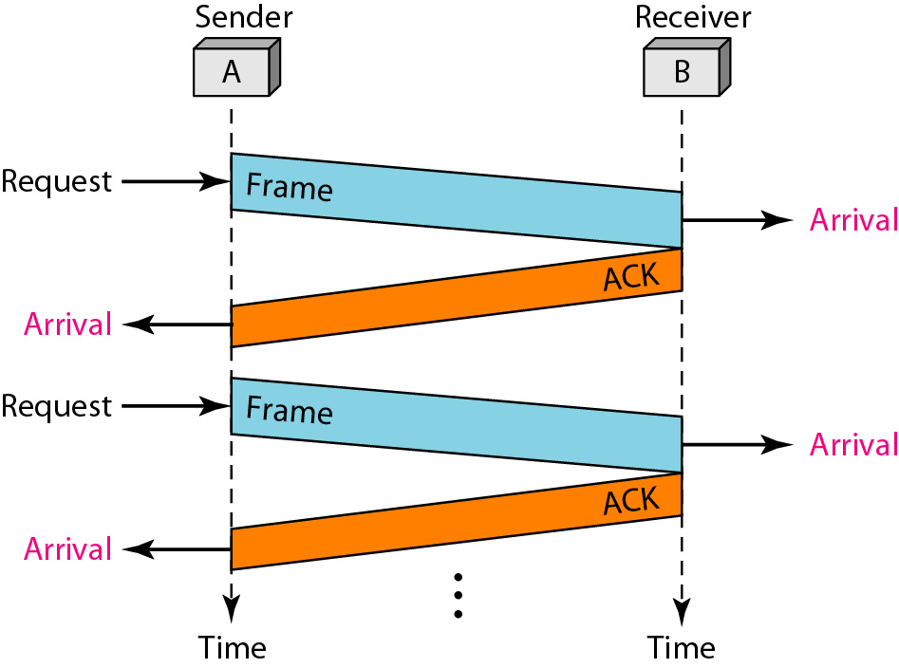
Example
Figure shows an example of communication using this protocol. It is still very simple. The sender sends one frame and waits for feedback from the receiver. When the ACK arrives, the sender sends the next frame.

Slide 17
NOISY CHANNELS
Stop-and-Wait Automatic Repeat Request Go-Back-N Automatic Repeat Request Selective Repeat Automatic Repeat Request

Slide 18
Error correction in Stop-and-Wait ARQ is done by keeping a copy of the sent frame and retransmitting of the frame when the timer expires.
In Stop-and-Wait ARQ, we use sequence numbers to number the frames.
The sequence numbers are based on modulo-2 arithmetic.
In Stop-and-Wait ARQ, the acknowledgment number always announces in modulo-2 arithmetic the sequence number of the next frame expected.

Slide 19
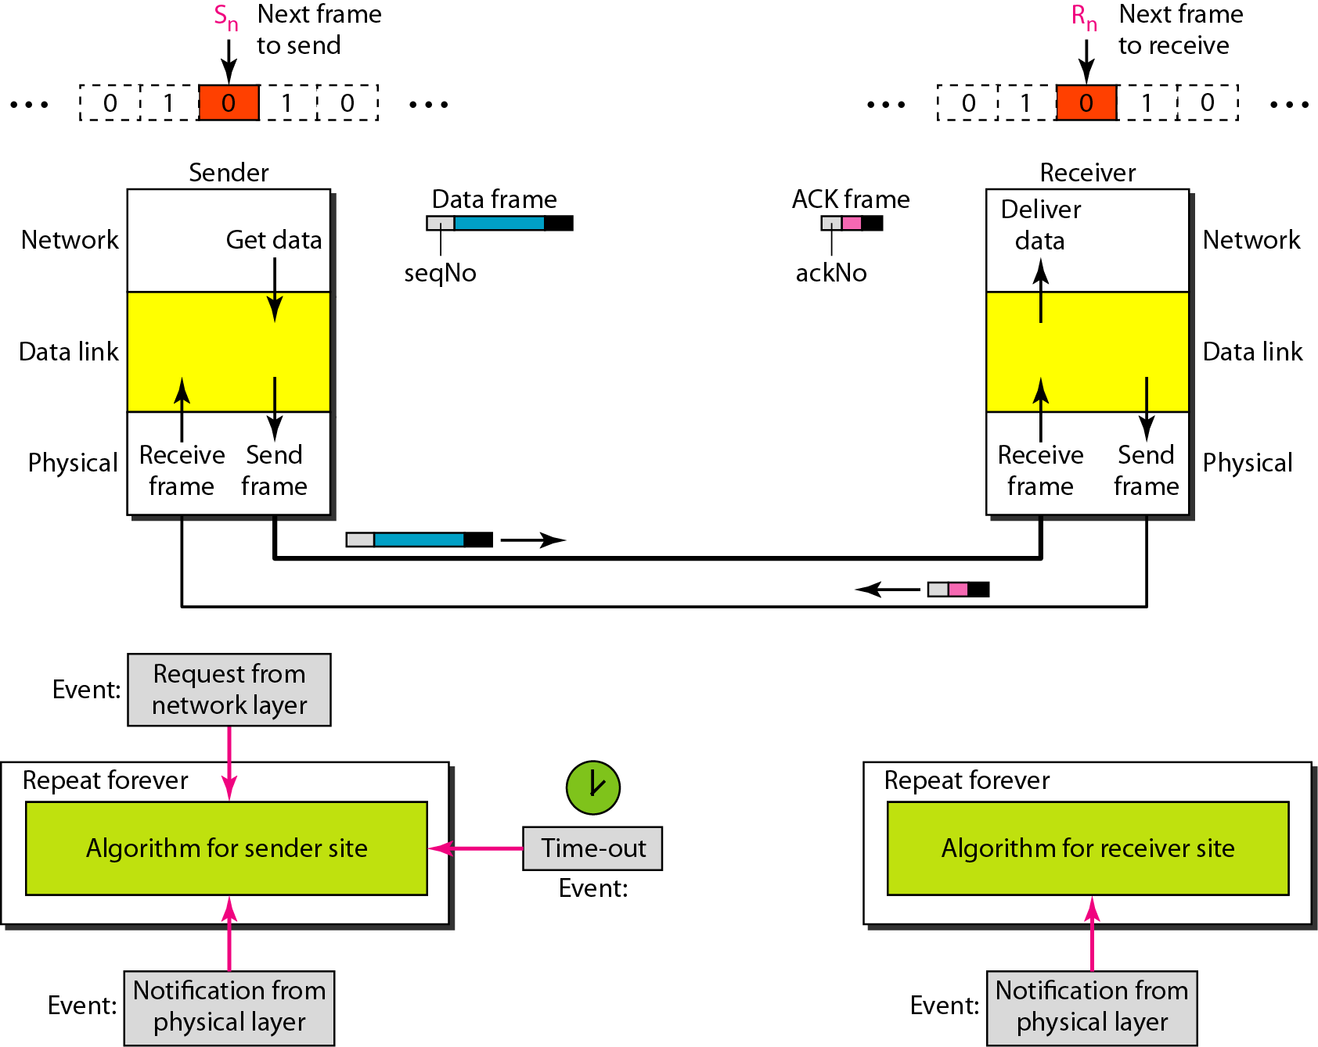
Design of the Stop-and-Wait ARQ Protocol

Slide 20
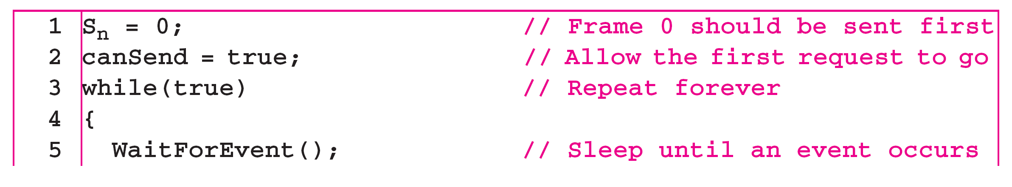
Algorithm Sender-site algorithm for Stop-and-Wait ARQ
(continued)

Slide 21
Algorithm Sender-site algorithm for Stop-and-Wait ARQ

Slide 22
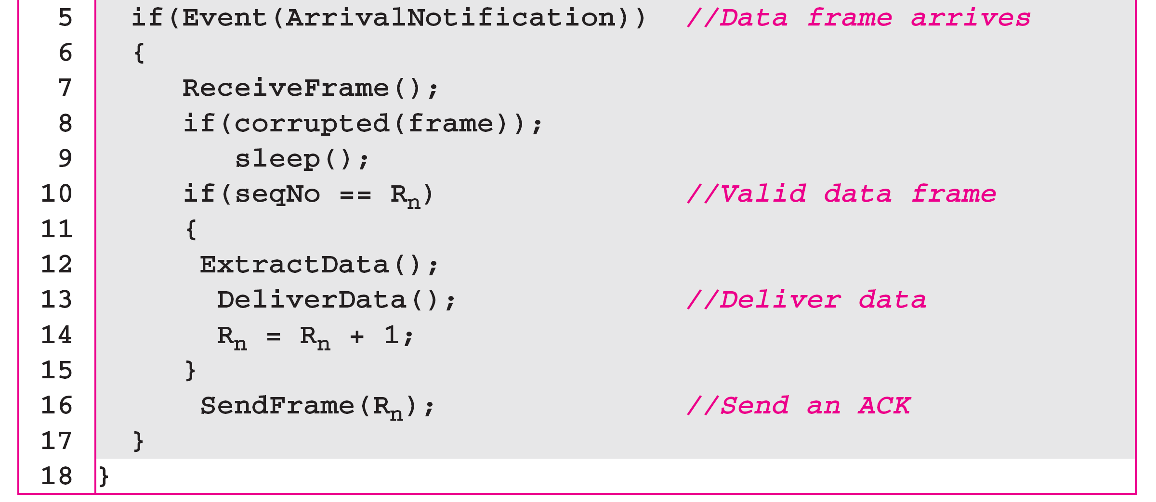
Algorithm Receiver-site algorithm for Stop-and-Wait ARQ Protocol

Slide 23
Example
Figure shows an example of Stop-and-Wait ARQ. Frame 0 is sent and acknowledged. Frame 1 is lost and resent after the time-out. The resent frame 1 is acknowledged and the timer stops. Frame 0 is sent and acknowledged, but the acknowledgment is lost. The sender has no idea if the frame or the acknowledgment is lost, so after the time-out, it resends frame 0, which is acknowledged.

Slide 24
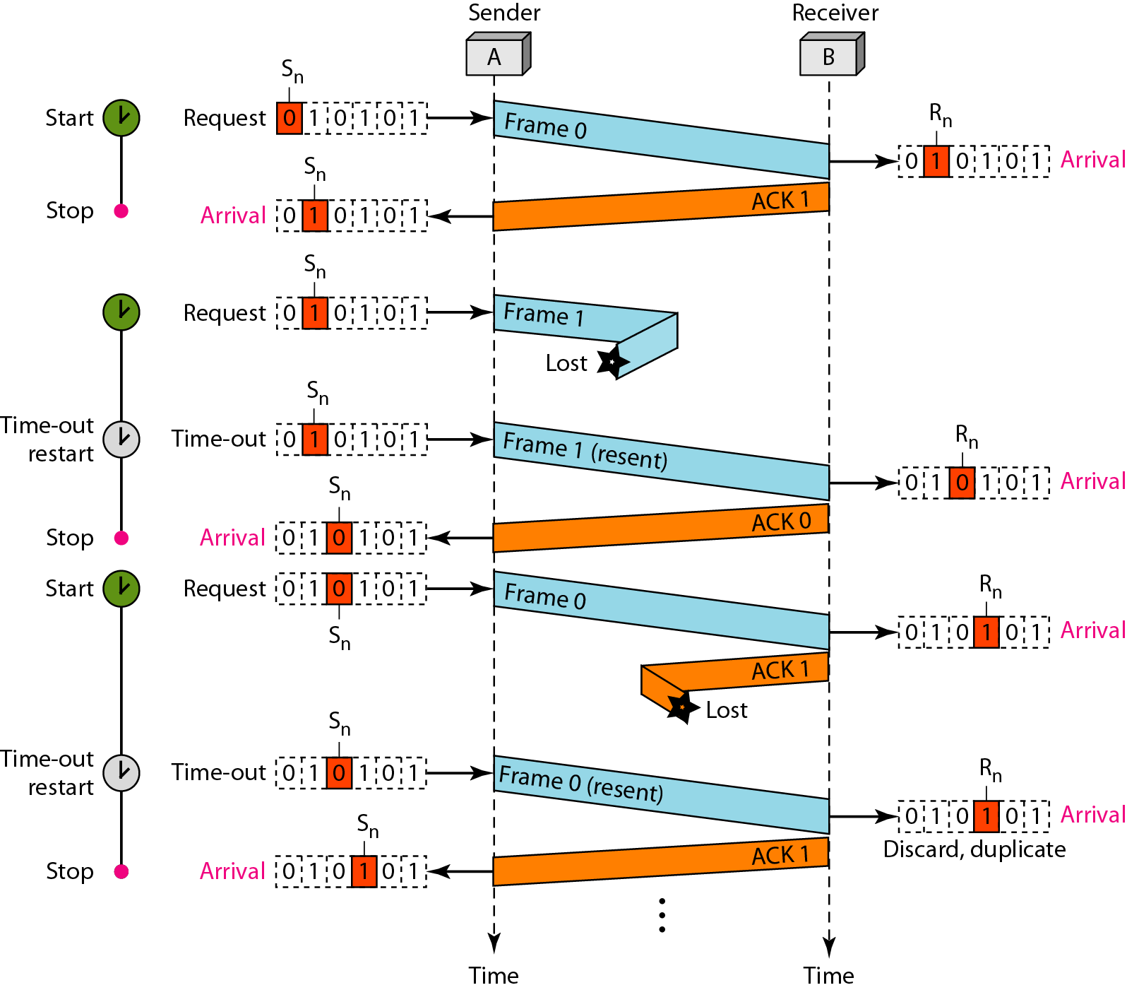
Figure Flow diagram

Slide 25
Example
Assume that, in a Stop-and-Wait ARQ system, the bandwidth of the line is 1 Mbps, and 1 bit takes 20 ms to make a round trip. What is the bandwidth-delay product? If the system data frames are 1000 bits in length, what is the utilization percentage of the link?
Solution
The bandwidth-delay product is
The system can send 20,000 bits during the time it takes for the data to go from the sender to the receiver and then back again. However, the system sends only 1000 bits. We can say that the link utilization is only 1000/20,000, or 5 percent. For this reason, for a link with a high bandwidth or long delay, the use of Stop-and-Wait ARQ wastes the capacity of the link.

Slide 26
Go-Back-N Automatic Repeat Request
In this protocol we can send several frames before receiving acknowledgements, we keep a copy of these frames until the acknowledgments arrive.
In this protocol, the sequence numbers are modulo 2^{m}, where m is the size of the sequence number field in bits.

Slide 27
Sliding Window
The Sliding window is an abstract concept that define the range of sequence numbers that is the concern of the sender and receiver.
The range which is the concern of the sender is called the send sliding window
The range that is the concern of the receiver is called the receive sliding window.
The send window is an abstract concept defining an imaginary box of size 2^{m} − 1 with three variables: Sf, Sn, and S_{size}.
The send window can slide one or more slots when a valid acknowledgment arrives.

Slide 28
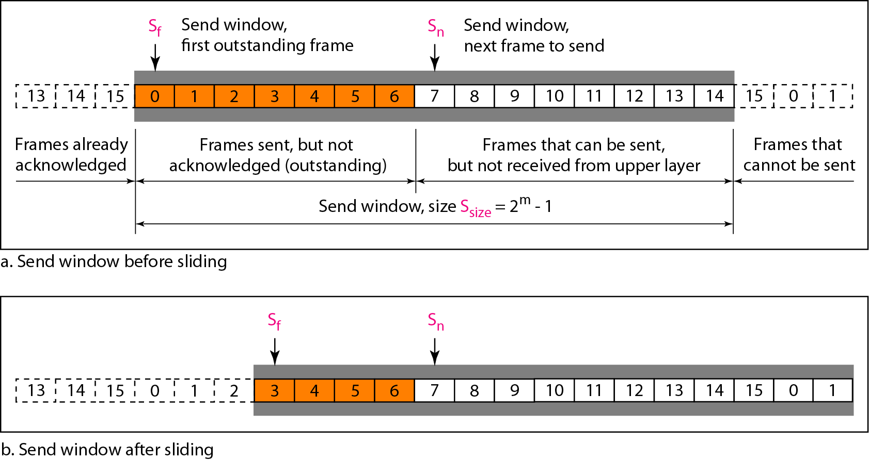
Send window for Go-Back-N ARQ

Slide 29
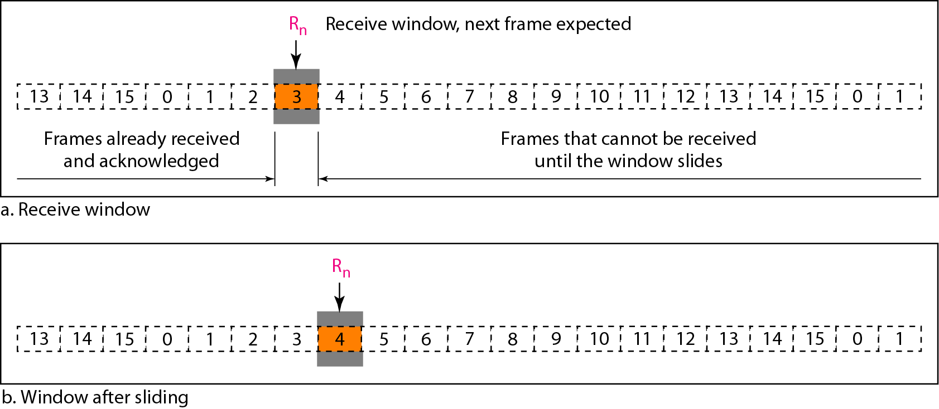
Receive window for Go-Back-N ARQ
The receive window is an abstract concept defining an imaginary box of size 1 with one single variable R_{n}. The window slides when a correct frame has arrived; sliding occurs one slot at a time.

Slide 30
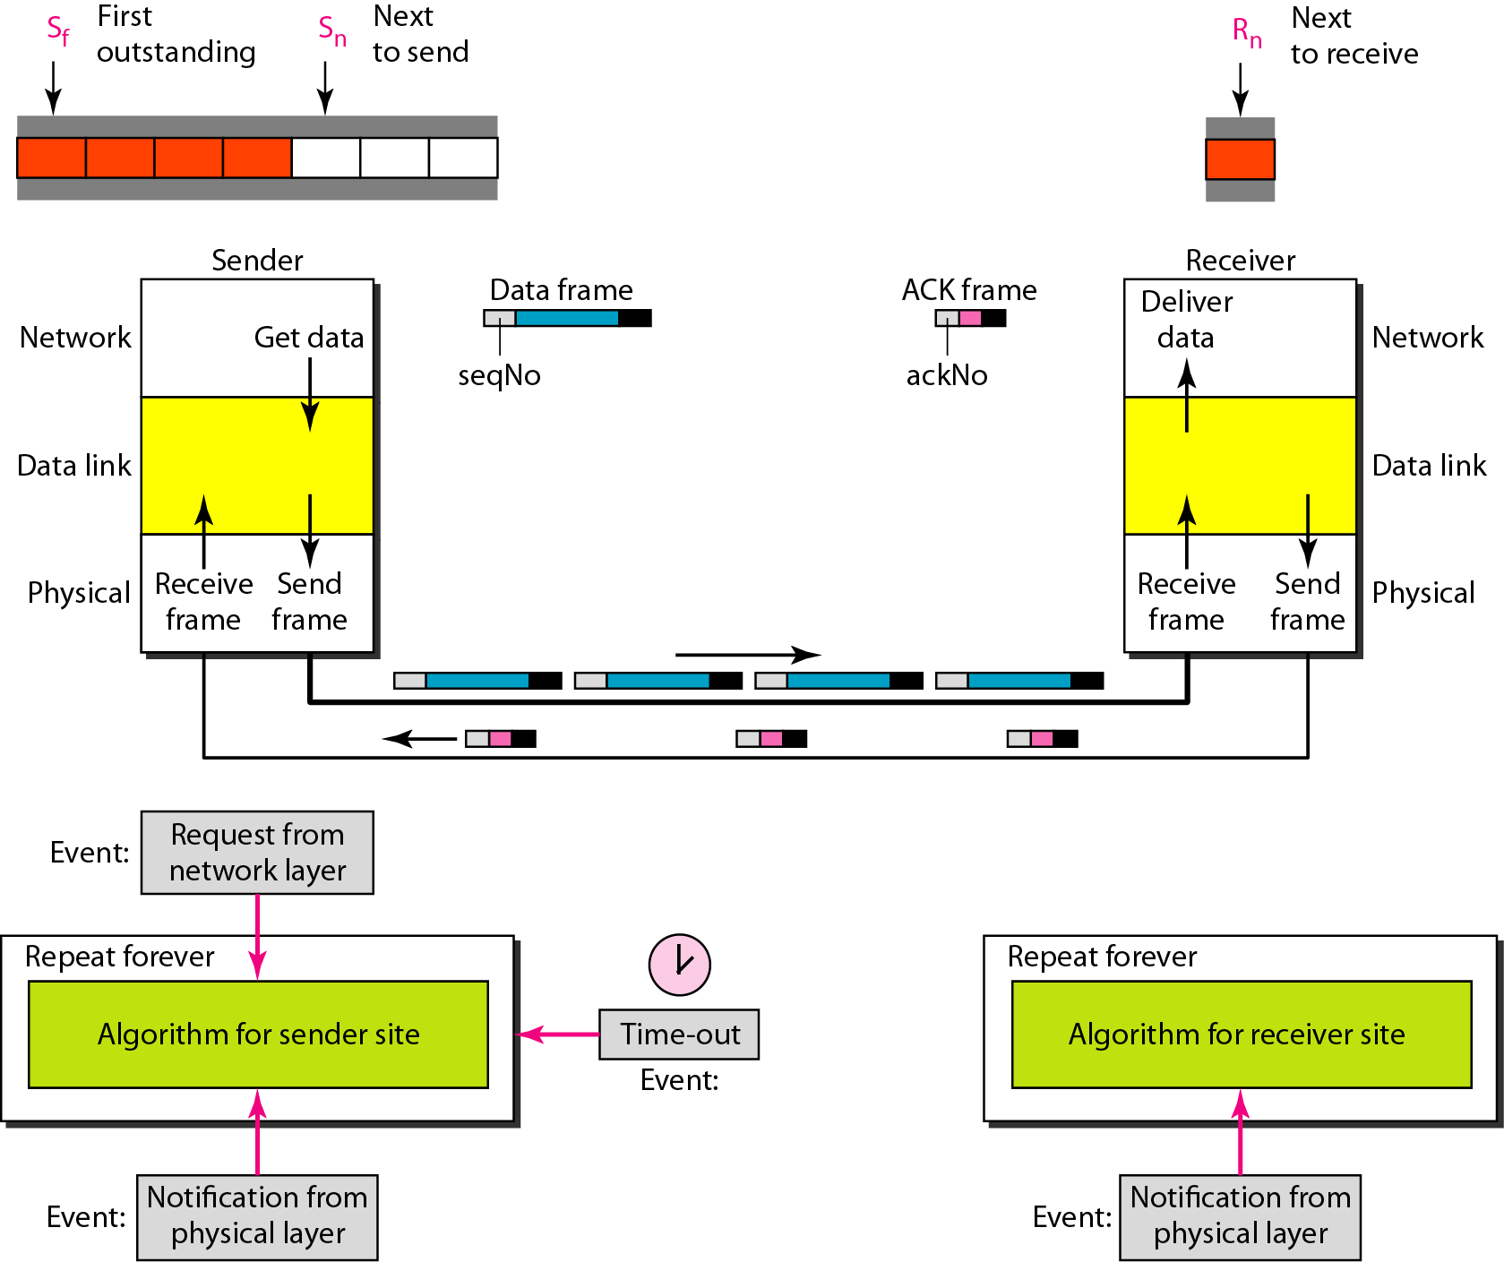
Design of Go-Back-N ARQ

Slide 31
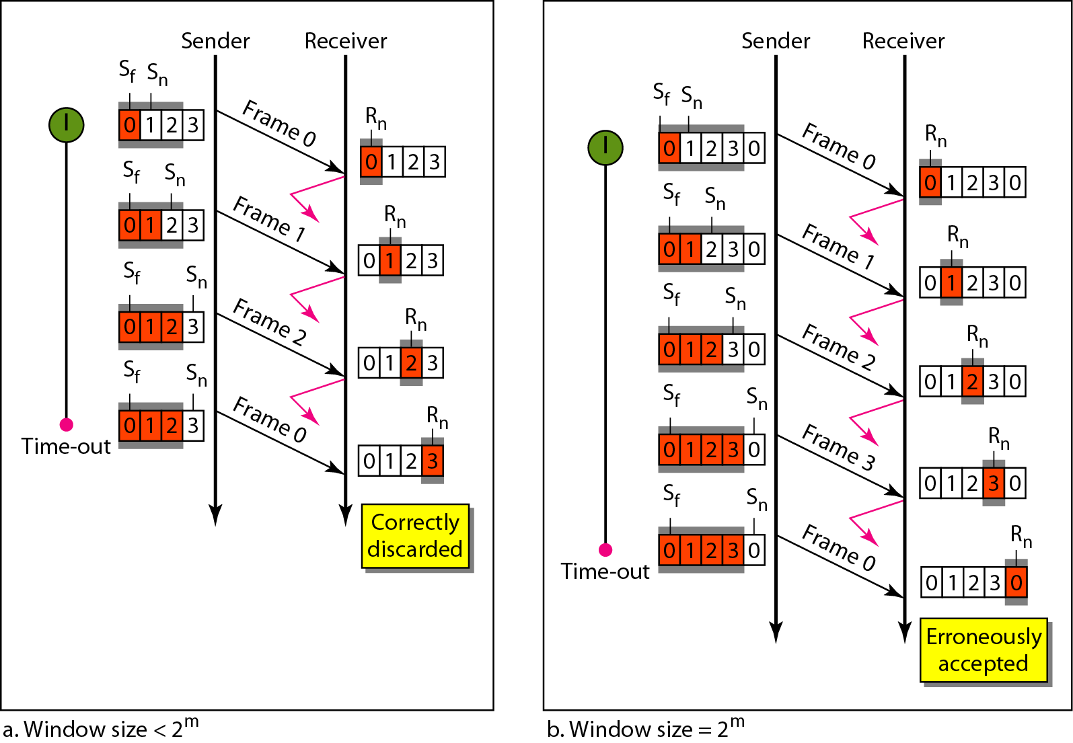
Window size for Go-Back-N ARQ
In Go-Back-N ARQ, the size of the send window must be less than 2^{m}; the size of the receiver window is always 1.

Slide 32
Algorithm Go-Back-N sender
(continued)

Slide 33
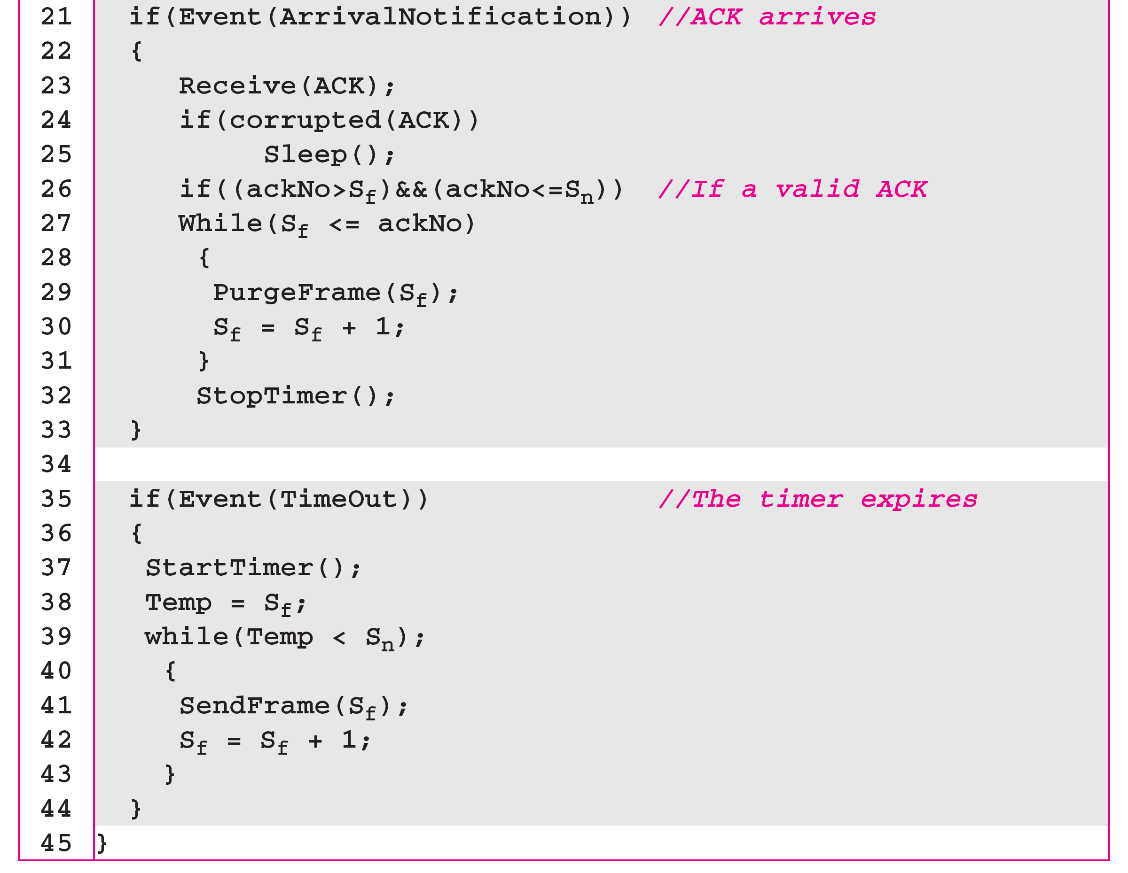
Algorithm Go-Back-N sender

Slide 34
Algorithm Go-Back-N receiver

Slide 35
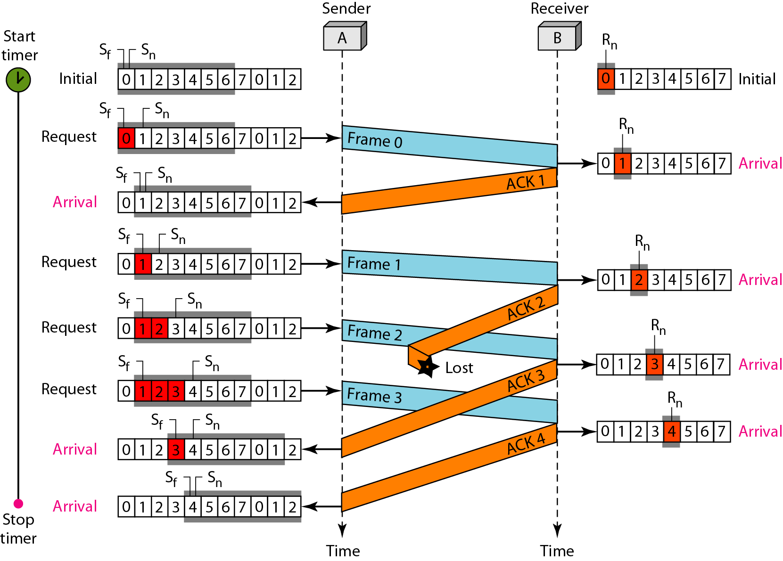
Example 1

Slide 36
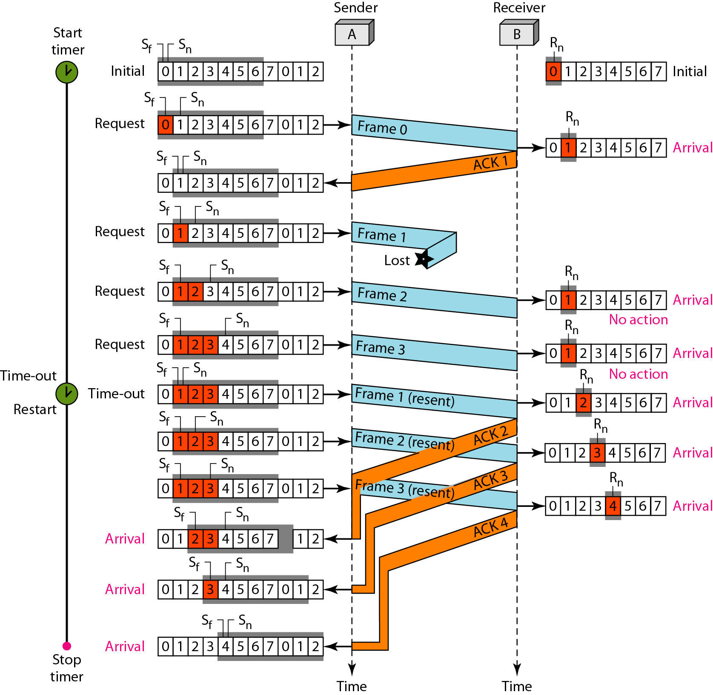
Example 2

Slide 37
Stop-and-Wait ARQ is a special case of Go-Back-N ARQ in which the size of the send window is 1.

Slide 38
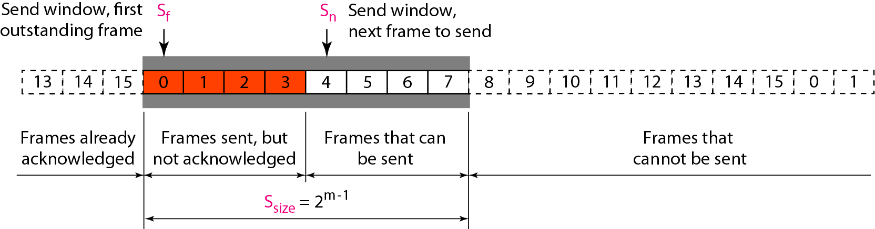
Selective Repeat ARQ
This protocol also uses two windows: a send and a receive window.
The size of the receive window is same as size of send window(2^{m-1}).
Send window for Selective Repeat ARQ

Slide 39
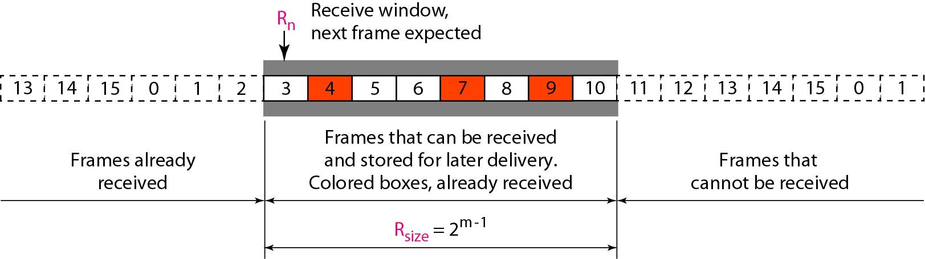
Receive window for Selective Repeat ARQ

Slide 40
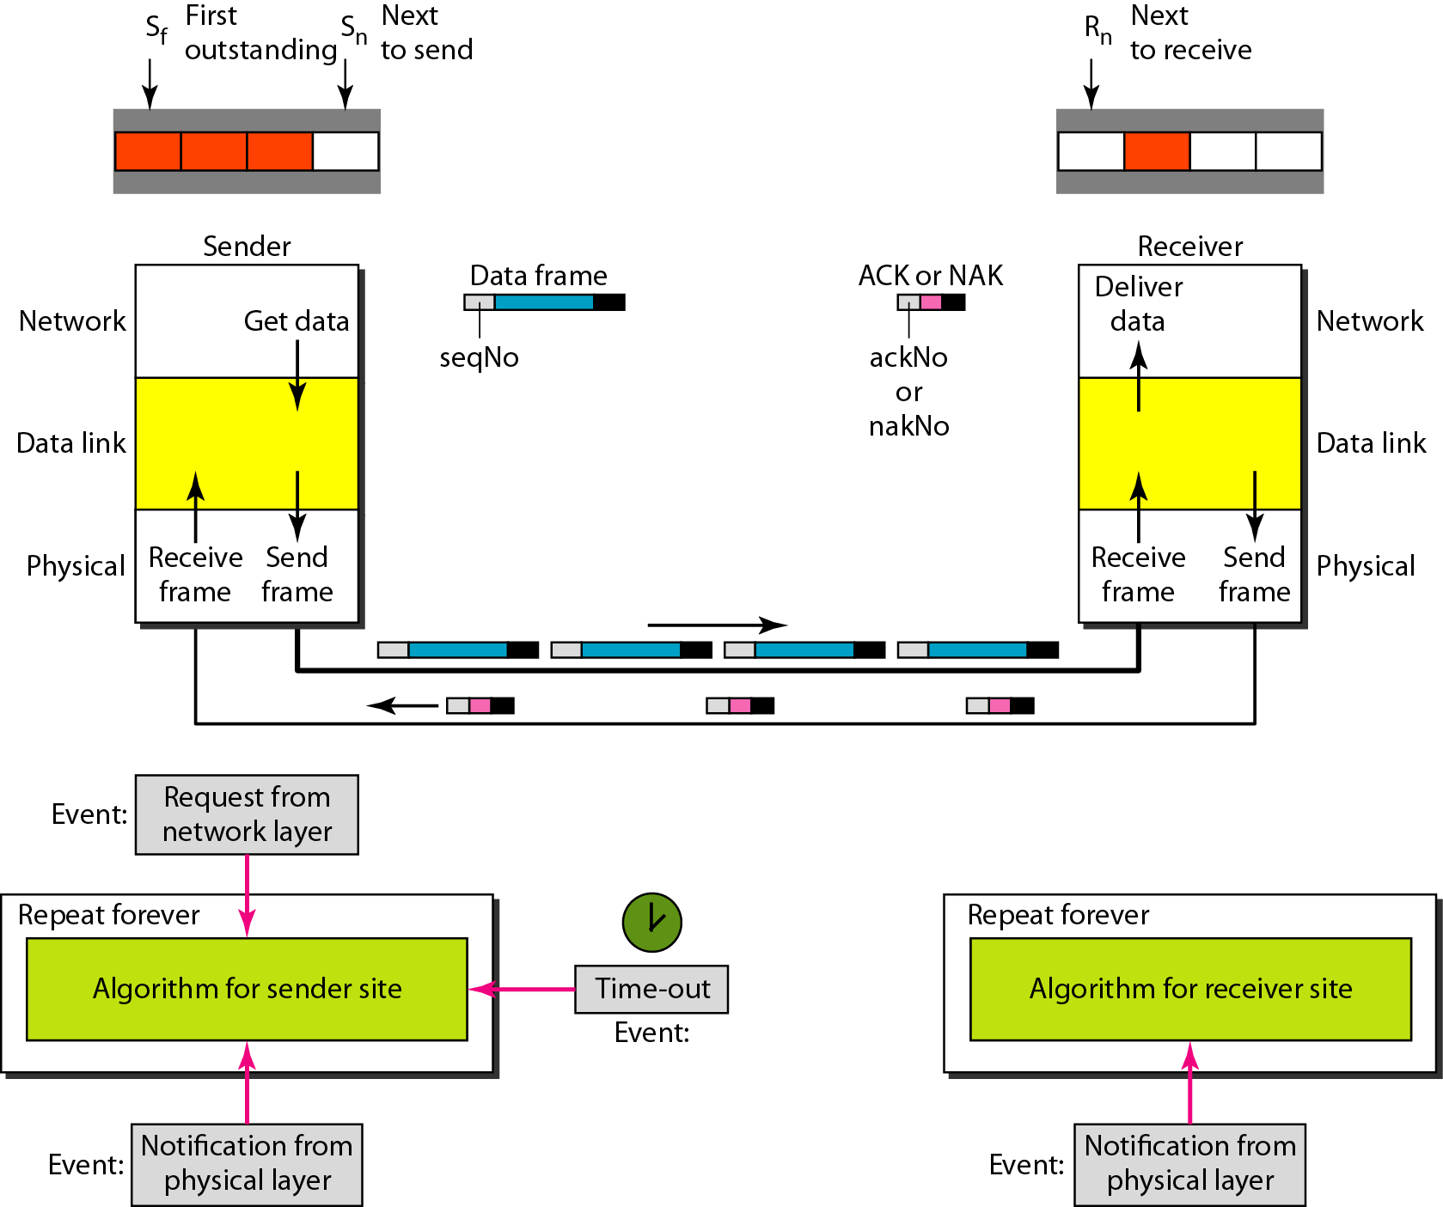
Design of Selective Repeat ARQ

Slide 41
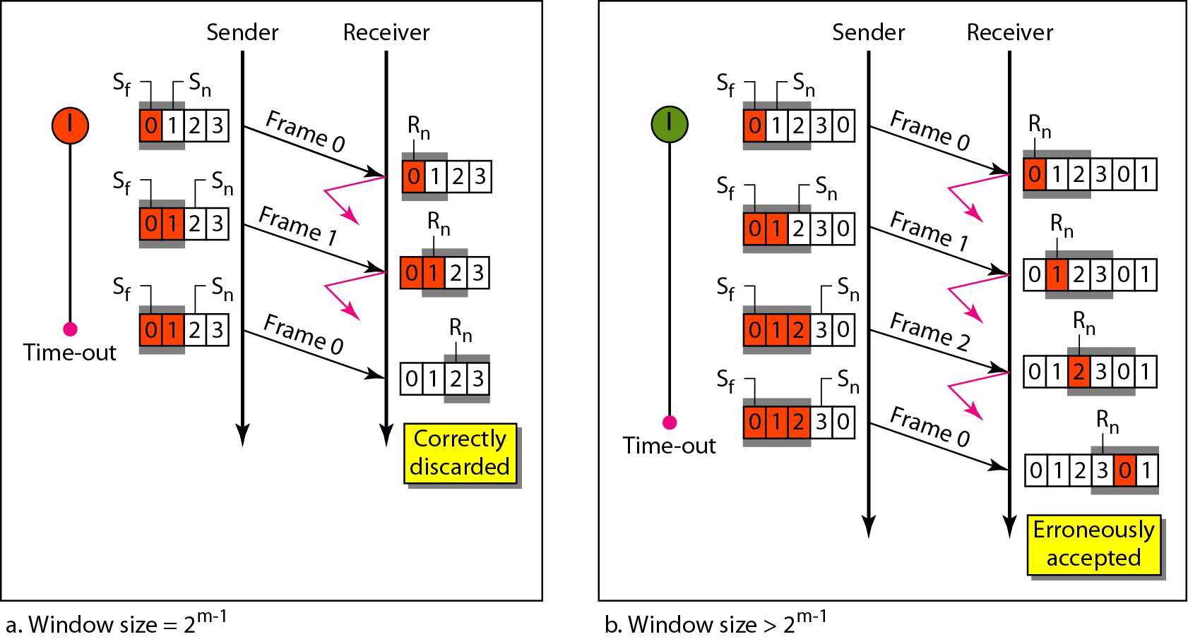
Selective Repeat ARQ, window size

Slide 42
Algorithm Sender-site Selective Repeat
(continued)

Slide 43
Algorithm Sender-site Selective Repeat
(continued)

Slide 44
Algorithm Sender-site Selective Repeat

Slide 45
Algorithm Receiver-site Selective Repeat

Slide 46
Algorithm Receiver-site Selective Repeat

Slide 47
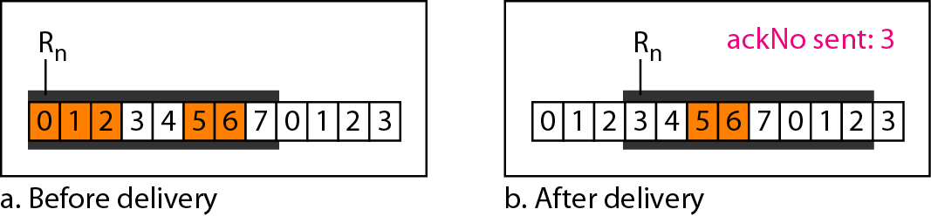
Delivery of data in Selective Repeat ARQ

Slide 48
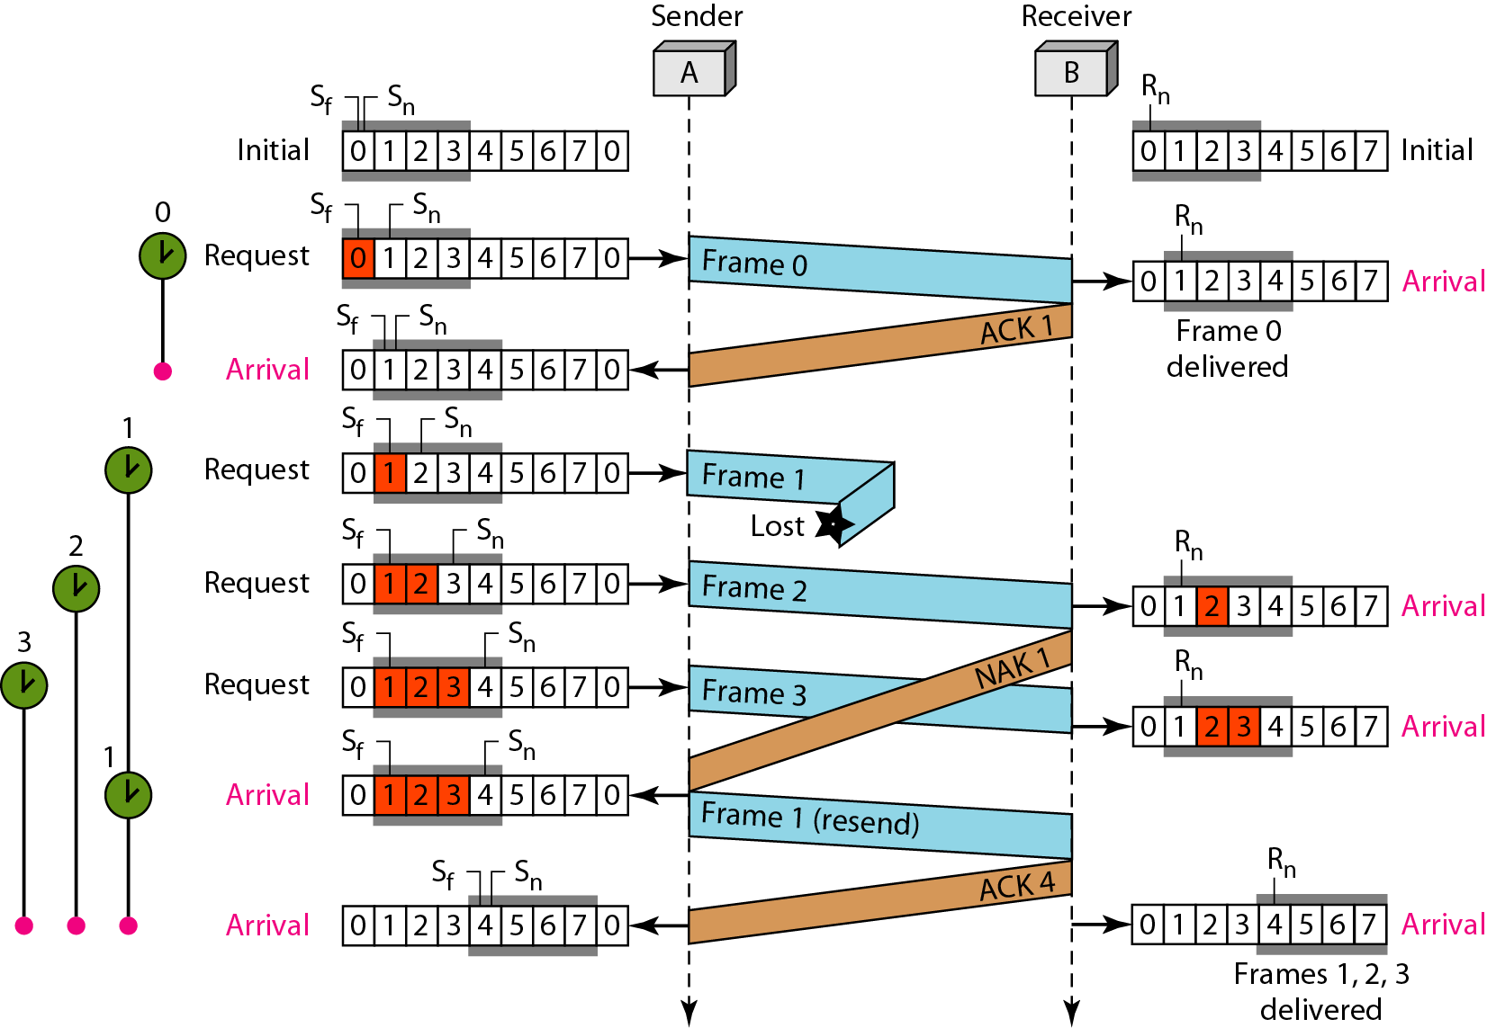
Example

Slide 49
Piggybacking
We have seen three protocols, all are unidirectional : data frames flow in only one direction although control information such as ACK and NAK frames can travel in other direction. In real life, data frames are normally flowing in both directions; from node A to node B and from B to node A. This means that the control information also needs to flow in both directions. This technique is called piggybacking.

Slide 50
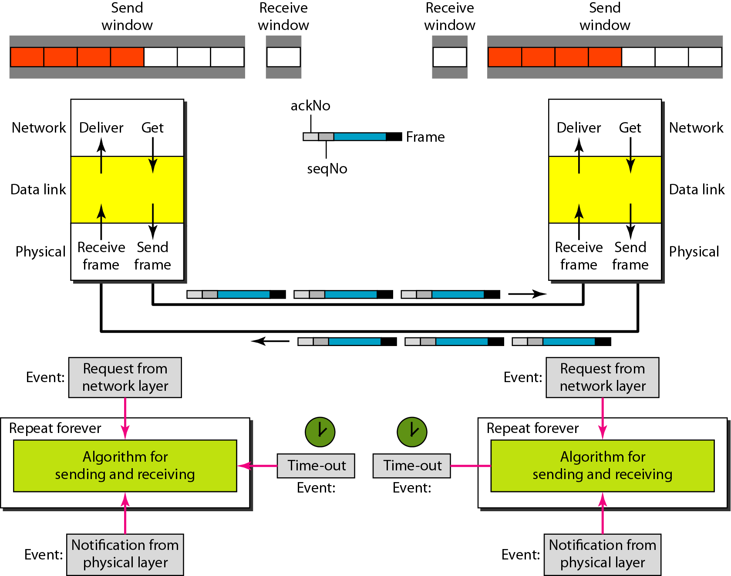
Design of piggybacking in Go-Back-N ARQ

Slide 51
HDLC
High-level Data Link Control (HDLC) is a bit-oriented protocol for communication over point-to-point and multipoint links. It implements the ARQ mechanisms.
Frames
Three types of frames:
1) I-frames (Information frames)
-It is used to transport user data and control information.
2) S-frames (Supervisory frames)
-It is used only to transport control information.
3) U-frames (unnumbered frames)
-It is reserved for system management.

Slide 52
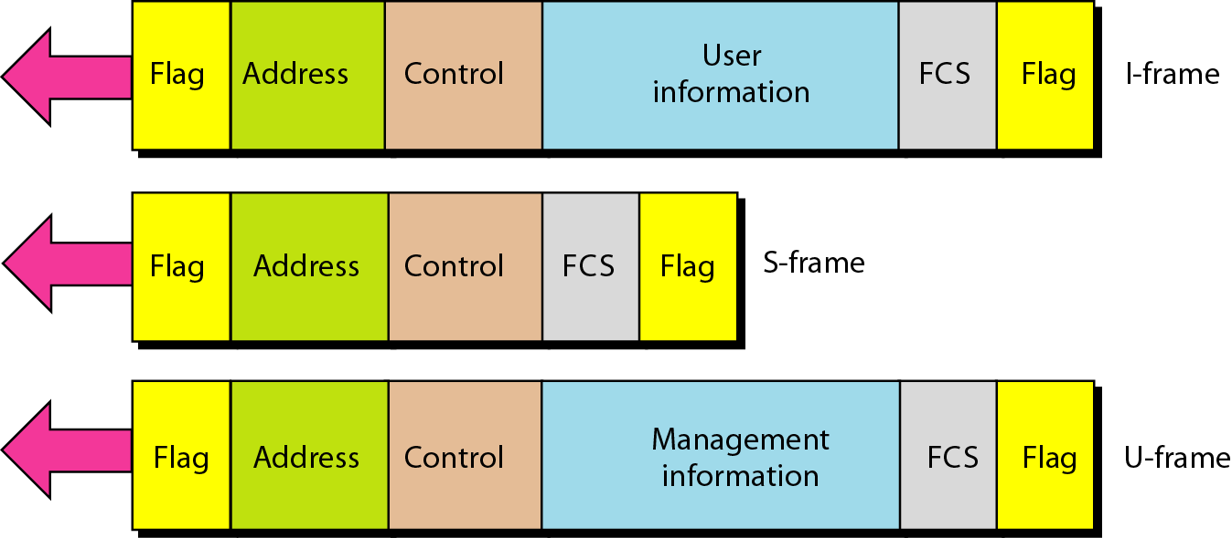
HDLC frames

Slide 53
Fields
Flag field : The flag field of an HDLC frame is an 8-bit sequence with the bit pattern 01111110 that identifies both the beginning and the end of a frame.
Address field : Address field of an HDLC frame contains the address of the secondary station.
Control field : The control field of an HDLC frame used for flow and error control
Information field : The information field contains the user’s data or management information.
FCS field : The frame check sequence(FCS) is the HDLC error detection field

Slide 54
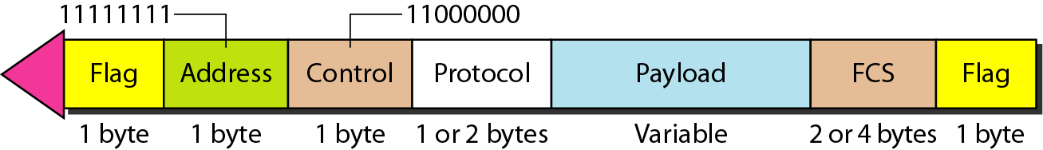
POINT-TO-POINT PROTOCOL
One of the most common protocols for point-to-point access is the Point-to-Point Protocol (PPP). PPP is a byte-oriented protocol.
PPP frame format

Slide 55
Fields
Flag field : The flag field of a PP frame is an 8-bit sequence with the bit pattern 01111110 that identifies both the beginning and the end of a frame and flag is treated as byte.
Address field : Address field of this protocol is a constant value and set to 11111111( broadcast address).
Control field : This field is also constant and set to 11000000. PPP does not provide any flow and error control.
Protocol field : This field defines what is being carried in the data field: either user data or the other information.
Payload field : This field carries either user data or the other information.
FCS field : The frame check sequence(FCS) is a 2-byte or 4-byte standard CRC.

